Slide 1
Signals & Systems
Note Set #1 - Overview
What is “Signals & Systems” all about???
1/5

Slide 2
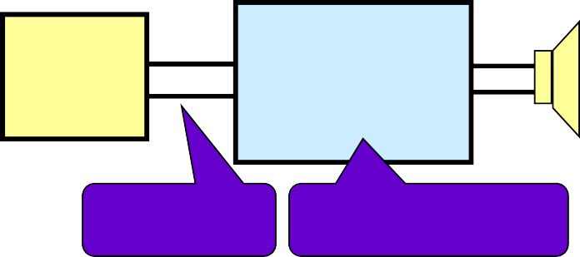
Signals & Systems
Because most “systems” are driven by “signals” EEs & CoEs study what is called “Signals & Systems”
“Signal” = a time-varying voltage (or other quantity) that generally carries some information
The job of the “System” is often to extract, modify, transform, or manipulate that carried information
So… a big part of “Signals & Systems” is using
math models to see what a system “does” to a signal
Physical System
System Model
v_{in}(t)
v_{out}(t)
Input x(t)
Output y(t)
Audio Amplifier
iPod
System
Math Function
Voltage
Electronics
Math “Model”
2/5

Slide 3
Some Application Areas
From Table 32.1 in Electrical Engineering Uncovered, 2nd Ed., by White & Doering
Application Area | Specific Uses of Signals & Systems
Telecommunications | Answering machines, modems, fax machines, cell phones, speaker phones
Speech and Audio | Voice mail, speaker verification, synthetic speech, audio compression (e.g., mp3)
Automotive | Engine control, antilock braking systems, active suspension, airbag control, system diagnosis
Medical | Hearing aids, remote monitoring, ultrasound imaging, magnetic resonance imaging (MRI)
Image Processing | 3D animation, image enhancement, image compression (JPEG), video compression (MPEG), high-definition TV
Control Systems | Head positioning in disk drives, laser control (e.g., printers, CD/DVD drives), engine & motor control, robots
Military & Aerospace | Radar & sonar, navigation systems (e.g., GPS), secure communications, missile guidance, battlefield sensors
In each of these areas you can’t build the electronics until your math models tell you what you need to build
2/5

Slide 4
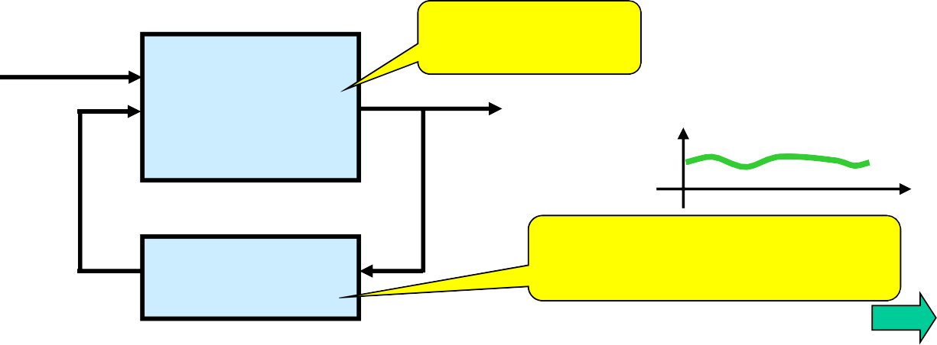
Five Common Signals & Systems Scenarios:
Given a system, determine a signal that will pass through it well
 e.g., Communication Transmitter
Given a type of signal, design a system that will pass it well
 e.g., Audio Amplifier
Design a system that will make a desired change to a signal
 e.g., Audio Equalizer
Design a system that will extract desired info from a signal
 e.g., Radar System or Communication Receiver
Design a system (and maybe signal) that gives a desired output
 e.g., Control System…. such as cruise control for a car
external forces: f_{e}(t)
The Car
speed: v(t)
t
Forward System
t
t
control forces: f_{c}(t)
Feedback
Cruise Control
4/5

Slide 5
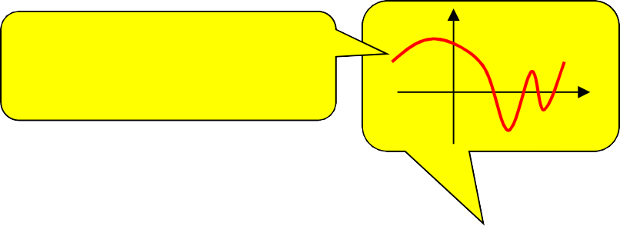
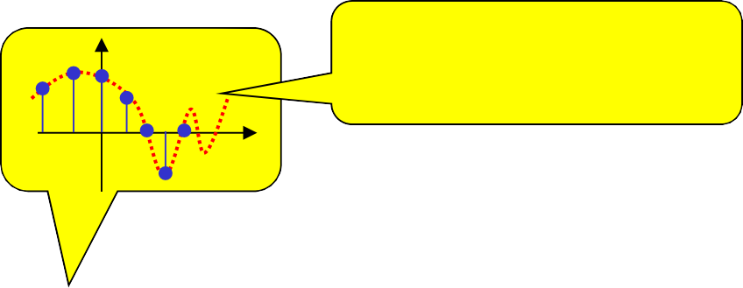
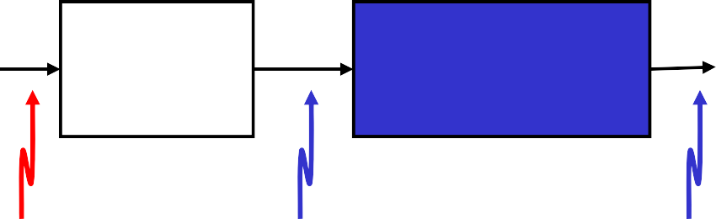
Continuous-Time & Discrete-Time
Modern systems generally…
get a continuous-time signal from a sensor
a cont.-time system modifies the signal
an “analog-to-digital converter” (ADC or A-to-D) sample the signal to create a discrete-time signal … a “stream of numbers”
A discrete-time system to do the processing
convert back to C-T signal with a “Digital-to-Analog Converter” (DAC)
x(t)
A time-varying voltage (or current)
x[n]
x[n] is just a “stream of numbers”
t
n
Sensor
Optional
Analog Electronics
Digital Elec. (Computer)
Electrical
D-T
ADC
DAC
Electrical
C-T
System
Physical
C-T
Signal
Electrical
C-T
Signal
Electrical
C-T Signal
Electrical
Electrical
Electrical
C-T Signal
5/5
D-T Signal
System
D-T Signal

